Slide 1
Academic Department Event Approval and Planning Procedure
All Chairs Meeting
April 16, 2026

Slide 2
Introduction
This procedure applies to non-course related events proposed by academic departments.
Planning can involve the collaboration of multiple departments including the Office of Events (OE), Academic Administration Department (AAD), and academic departments.
Notes:
This procedure applied to non course related events that are proposed by academic departments regardless of size, format, or budget. This procedure excludes retreats and intensives, as well as events proposed by non-academic departments.
Planning can involve the collaboration of multiple departments including the Office of Events (OE), Academic Administration Department (AAD), and academic departments.

Slide 3
Event Types and Definitions
Large Events | Medium Events | Small Events
50 or more attendees Over 100 hours of planning Examples: conferences and symposiums Planned by OE | Less than 50 attendees 10-100 hours of planning Examples: workshops, panels, salons, book launches, presentations, lectures, guest speakers Planned by AAD | Less than 10 planning hours Minimal planning components Example: virtual event Planned by AAD
Notes:
I have made a distinction between three types of events: large, medium, and small. Reason for making this distinction is primarily to think about which office will be handling which types of event. So as you can see here, large events will be handled by Office of Events (state bullets). Medium and small events planned by AAD (state bullets).

Slide 4
Staff Roles
Academic Department Lead(s) | OE Manager/AOS | Student Workers
Representative from the academic department Creates the vision, target audience, modality, institutional alignment Informs scholarly content Provides direction and approves programming Recruits presenters | Creates event schedule and work plan Collects materials such as presentations and bios Manages catering, venue, and supply logistics Liaises with vendors and other departments Books lodging accommodations Manages event budget and processes payments Coordinates presenter contracts with Legal Affairs Coordinator | Assists with specific event tasks: Creating flyers, newsletters, and social media content Designing programs and other print materials Creating SharePoint news posts Event setup/cleanup
Notes:
Every event should have an academic department lead such as a Chair or faculty member who plans the event in collaboration with OE or AAD. This person typically is in charge of (read bullets)
As mentioned, every event will be assigned to an OE Manager or AOS who manages all logistics including (read bullets)
For events overseen by AAD, we have often have student workers who help us with specific tasks such as (read bullets)

Slide 5
Event Approval Process
Notes:
There are different approvers and submission deadlines based on the size of the event.

Slide 6
Large Event Approval Process
Deadline to approve: 1 year in advance and during the AY budget planning process
Three required approvals:
Department Chair: Program alignment
Vice Provost: Budget approval
OE: approval criteria based on staffing capacity, available space, sufficient lead time, etc.
Once approved, event is assigned to an OE event manager
Notes:
For large events, we’d like folks to get in the mindset of planning around 1 year in advance. The reason for that is because most large events will have a budget. That budget line is negotiated in the fall of the previous fiscal year. By ideating your event one year in advance, it will ensure you have the appropriate budget amount set aside for the event. Each year, I will be sending an email out to Chairs in the fall to remind them to submit their large event requests for the following fiscal year and to include the event budget amount when doing budget planning with Michelle Eng.
There are three needed approvals for large events:
If it’s a faculty who is proposing an event, they must inform their chair and obtain their approval.
As previously discussed, Michelle Eng must approve the budget for the event
OE approves the large events based on the following criteria:
Staffing capacity to support event
Availability of requested on-campus space
Sufficient lead time for event planning
Event times fall within building hours
Building has technical capacity to support the event
Event is viable with proposed budget and timeline
Can I submit my event more than 1 year in advance? Yes you can. TID proposed an event for fall 2027 and we’re keeping track of it for when the budget planning process takes place this fall. But no more than 3 years in advance.
Will my large event get approved if its proposed after the budget planning process?
A large event can still be approved after the AY budget planning process if there is at least 6 months of lead time and it meets the OE criteria. However, you would have to have a plan for how you will pay for the event. So maybe money is coming from another source.
Lastly, event proposals are on a first come first serve basis so if 4-6 events are submitted 1 year beforehand, OE may not have capacity to plan additional events that are proposed during the same academic year. Their preference is for you to submit an idea of when you want to hold the event but to be flexible with the dates.
Once approved, the event will be assigned to an OE manager.
I will get to how to submit shortly.

Slide 7
Medium Event Approval Process
Deadline to approve: 4 months in advance and before the start of the semester
Two required approvals:
Department Chair: Program alignment
AAD Director and Manager: approval criteria based on budget, staffing capacity, available space, sufficient lead time, etc.
Once approved, the requester can begin working with the AOS.
Notes:
First, here is the approval process for medium events:
AAD needs about 4 months of lead time and before the start of the semester. We want folks to let us know about all your events before the start of the semester because it greatly helps with our planning process including confirming staffing capacity and having staff sign up for shifts.
Similar to the large event approval process, you will need chair approval, as well as AAD approval. Collin and I will look at the event proposal and use a similar criteria to OE. We will also check your department budget for adequate funds if applicable.
Can I submit my event before 4 months? Yes please
Can I still get approval if I submit my event less than 4 months in advance? Yes, but we may not be able to provide the same level of staff support depending on our capacity.
Once approved, you can begin working with your AOS.

Slide 8
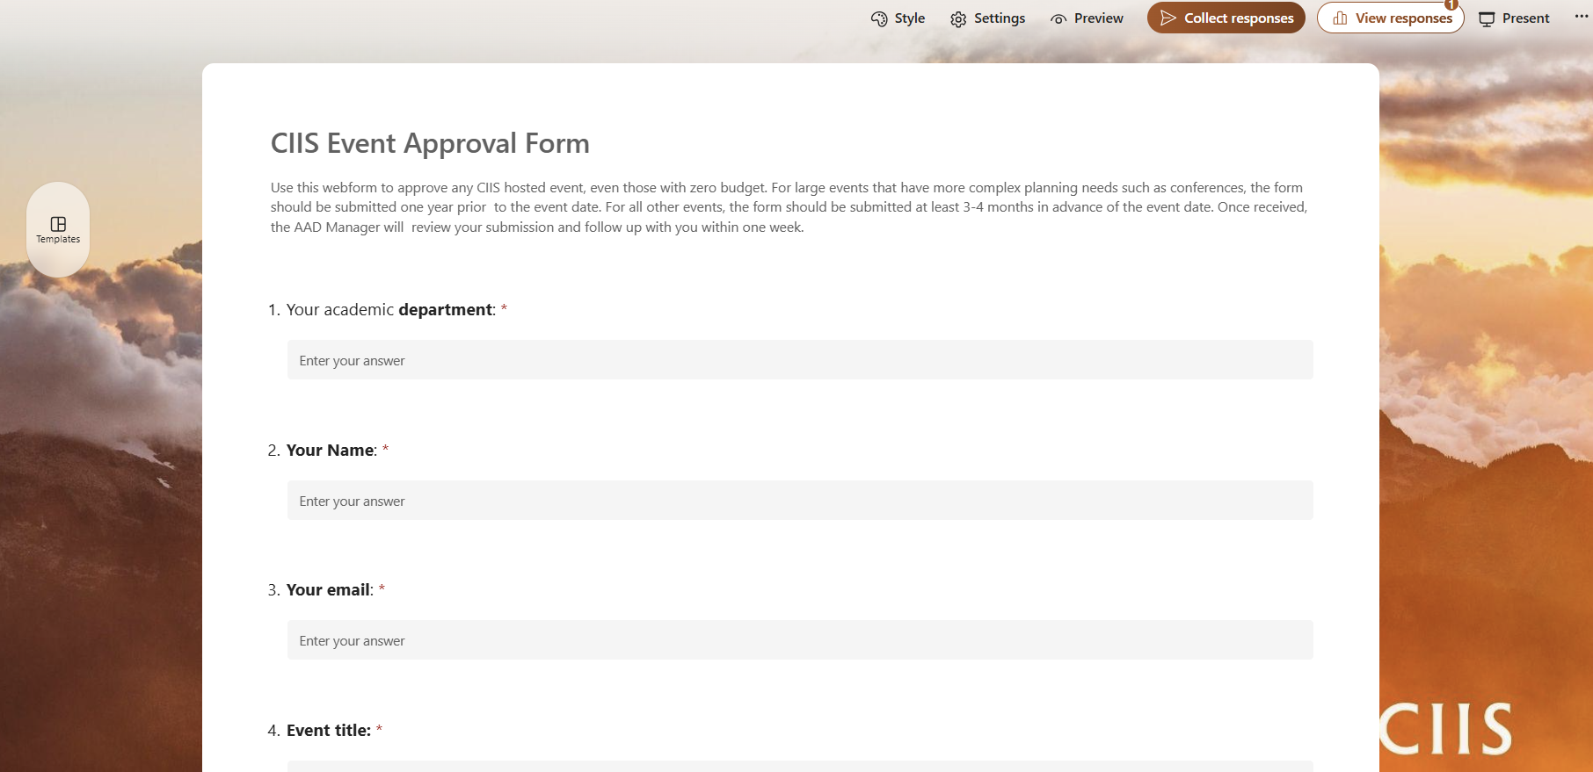
Event Approval Webform
Event Approval Webform required for large and medium events.
Notes:
For large and medium events, we would like you to complete this Microsoft webform. The link to the form is located on the AAD SharePoint Page and is currently active. This form submission will serve as the mechanism for notifying me of your proposed event and initiating the approval process and it will help me determine whether the event will be managed by Office of Events or AAD.
How it works is I will receive a notification once an event proposal is submitted. I will determine the size of the event. If it’s a large event, I will request approvals from Michelle and OE. Once approved, you will hear from Events. If its medium, Collin and I will assess and respond to the requester.

Slide 9
Small Event Approval Process
Deadline to notify AOS: 1 month prior to event date
No formal approval required
The requester notifies the AOS and planning can begin immediately
Notes:
Small events that do not have a budget, involve less than 10 hours of planning, and have minimal components still need to be submitted before the beginning of the semester and at least one month before the event date. Small events are not required to go through a formal approval process and are exempt from completing the Event Approval form. The requester can work directly with the AOS without the involvement of the AAD Director or Manager.

Slide 10
Planning Process

Slide 11
Large Event Planners
OE Manager works with
the academic department lead on all logistical tasks
AOS is secondarily involved in supporting specific tasks
Notes:
This is where you emphasize OE manager will do ALL logs. The AAD is secondarily involved in supporting specific tasks associated with large events. The AAD Director and AOS work with the OE Manager and academic department lead to outline those tasks. Tasks are determined on a case-by-case basis and could include budget management, ordering and purchasing, expense reporting, requesting a credit card limit increase, Eventbrite monitoring, and staffing.

Slide 12
Medium and Small Event Planners
AOS works with the academic department lead on all logistical tasks
Student Worker is secondarily involved in supporting specific tasks

Slide 13
Room Reservations
Non-Course Related Bookings | Course Related Bookings
Priority: Namaste Hall, Café, and 1st floor lobby Booking: First come first serve Can book classrooms but have to wait until after class schedule publishing date | Priority: classrooms Booking: arranged by Registrar and AAD Limited bookings for Namaste Hall
Notes:
Non-course Related Events
Namaste Hall and the 1st floor lobby are primarily reserved for non-course related events. These spaces can be reserved on a first come first serve basis. If a non-course related event requires classroom bookings, those reservations are dependent on the course planning timeline since in-person courses take priority of classroom use. Classrooms for spring semester events can be reserved starting in November once the class schedule is published. Similarly, rooms for fall events can be made starting in April. The OE Manager and AOS use Mazevo to reserve an available room. Namaste Hall reservations, regardless of timing, need to be approved by OE. The AOS emails events@ciis.edu to inquire about Namaste Hall availability. Refer to the Mazevo Training here.
Course-Related Events
Course-related events can still use Namaste Hall and 1st floor lobby, dependent on availability and approval from the OE. For information about how to book classrooms for courses, refer to the procedure: Setting the day, time, and location of synchronous courses.
For course related bookings for Namaste Hall: if no events, can be available but not set up and can’t use tech. Must set up own room if need tables and chairs.
Course bookings- don’t go through Events! Just AAD

Slide 14
Working with Other CIIS Departments
Office of Events | OSCR | DoT | Facilities
Provides linen, vases, water carafes, tables and chairs Approves Namaste Hall and lobby bookings Provides event advice and vendor recommendations | Prioritizes large public facing events Creates event webpages Posts on social media Reviews design drafts Provides promotion guide (see Media Kit) Takes photos/videos Writes/publishes news stories | Creates Zoom link and settings for virtual/hybrid events Records live and virtual events Facilitates online event spaces | Books parking spaces Provides equipment Transports furniture or supplies
Notes:
This is how you can work with different departments on your event planning:
Events- let Alex talk
OSCR- they are much more hands on with managing the marketing and communications for large public facing events. For all other events, it’s the AOS who will be doing all marketing and communication. But OSCR will do the following for all events (read slide)
Read DoT and Facilities
Another department that I did not mention but is critical to the planning process is Finance. If you will be spending more than your $2,500 credit card limit within one month, you can have your OE manager or AOS work with me to request a credit card limit increase. We would need to know the EXACT increased amount per month and this request should be made ideally 3 months in advance.

Slide 15

Event Planning Checklist
Notes:
Event Planning Checklist

Slide 16
Questions
Notes:
Keep an eye out for reminder emails

